Slide 1

Project Title -Retail Insights from Superstore Data
[JADA VISWATEJA ]

Slide 2

PROBLEM STATEMENT
The "Retail Insights from Superstore Data" problem statement involves analyzing a fictional superstore's sales data to gain actionable insights for improving business performance, profitability, and operational efficiency. The core task is to examine historical sales data to identify trends, underperforming products or regions, and profitable areas, in order to develop strategies for growth, optimize inventory, and make informed data-driven decisions.

Slide 3
ProjectDescription: The project will provide the management of Global Superstore with a clear, data-backed understanding of their business. It will enable them to make informed decisions on inventory management, marketing campaigns, discount strategies, and regional focus. This will ultimately lead to increased profitability, optimized operations, and a stronger competitive position in the market. The project serves as a model for how data analytics can be leveraged to solve complex business problems.

Slide 4

WHO ARE THE END USERS?
The end users of the "Retail Insights from Superstore Data" project are the individuals and teams within the Global Superstore company who will utilize the findings to make strategic decisions. These end users can be broadly categorized as:
Senior Management and Executives: They need high-level summaries and key performance indicators (KPIs) to understand overall business health, make strategic decisions, and allocate resources.
Sales and Marketing Teams: These teams need insights into customer segments, product performance, and regional sales trends to design effective marketing campaigns, target promotions, and improve sales strategies.
Regional Managers: They use the analysis to understand the performance of their specific regions, identify local market opportunities or challenges, and make operational decisions.
Operations and Supply Chain Teams: They can use the data to optimize inventory levels, forecast demand, and improve the efficiency of the supply chain and shipping processes.
Product Managers: They need to know which products and categories are most profitable or underperforming to inform product development and portfolio management decisions.

Slide 5

Technology Used
Programming Language: Python (for data manipulation, analysis, and cleaning).
Libraries: Pandas, NumPy, Matplotlib, Seaborn (for data analysis and visualization).
Visualization Tools: Tableau or Power BI (for creating interactive dashboards and reports).
Database: SQL

Slide 6
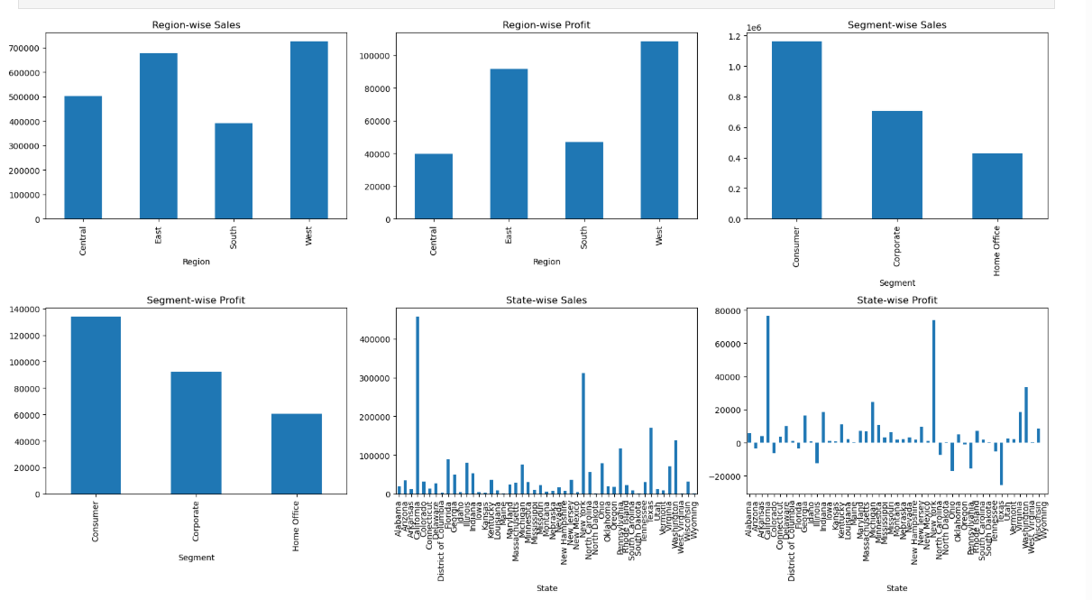
RESULTS
[Add screen shots of your code ]
Demo Link

Slide 7
Thank you
.
.

